Slide 1

Commit Transaction

Slide 2
SQL Transactions
A transaction is a unit or sequence of work that is performed on a database. Transactions are accomplished in a logical order, whether in a manual fashion by a user or automatically by some sort of a database program.

Slide 3
Transactional Control Commands
Transactional control commands are only used with the DML Commands such as - INSERT, UPDATE and DELETE. They cannot be used while creating tables or dropping them because these operations are automatically committed in the database. COMMIT − to save the changes.

Slide 4
The COMMIT Command
The COMMIT command is the transactional command used to save changes invoked by a transaction. It saves all the transactions occurred on the database since the last COMMIT or ROLLBACK.
The syntax for the COMMIT command is as follows.
COMMIT;

Slide 5
Example
CREATE TABLE CUSTOMERS (
ID INT NOT NULL,
NAME VARCHAR (20) NOT NULL,
AGE INT NOT NULL,
ADDRESS CHAR (25),
SALARY DECIMAL (18, 2),
PRIMARY KEY (ID)
);
INSERT INTO CUSTOMERS VALUES
(1, 'Ramesh', 32, 'Ahmedabad', 2000.00),
(2, 'Khilan', 25, 'Delhi', 1500.00),
(3, 'Kaushik', 23, 'Kota', 2000.00),
(4, 'Chaitali', 25, 'Mumbai', 6500.00),
(5, 'Hardik', 27, 'Bhopal', 8500.00),
(6, 'Komal', 22, 'Hyderabad', 4500.00),
(7, 'Muffy', 24, 'Indore', 10000.00);
DELETE FROM CUSTOMERS WHERE AGE = 25;
COMMIT;

Slide 6
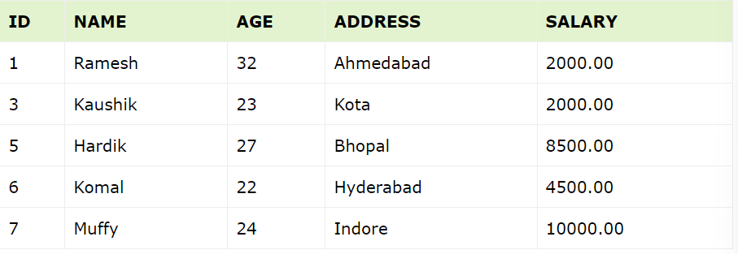
SELECT * FROM CUSTOMERS;

